Slide 1
Development of an Energy Management System for demand response programs within smart DC houses.
Herr Abhik Ghosh

Slide 2
Contents
Motivation
AC and DC house system
Energy management system
Case study
Results
Conclusion

Slide 3
1. Motivation
House system
European “energy road map 2050”
Distributed renewable energy sources.
25% of energy in household sector.
Heat storage, heat pump, battery storage, PV and EV.

Slide 4
2. AC and DC house system
AC house
DC house

Slide 5
3. Energy management system
House consumption
Heat pump

Slide 6
House consumption loads without BESS
House consumption power
Power difference

Slide 7
House consumption loads with BESS
Self consumption (SC)
Power difference

Slide 8
4. Case study
Winter days
Summer days

Slide 9
Off grid
Winter days
Summer days

Slide 10
Price signal based Demand response (DR)
Price function

Slide 11
Price signal based DR
Winter days
Summer days

Slide 12
Battery energy storage system
Off grid
Price signal based DR

Slide 13
One year house response
Off grid
Price signal based DR

Slide 14
Power difference
Off grid
Price signal based DR

Slide 15
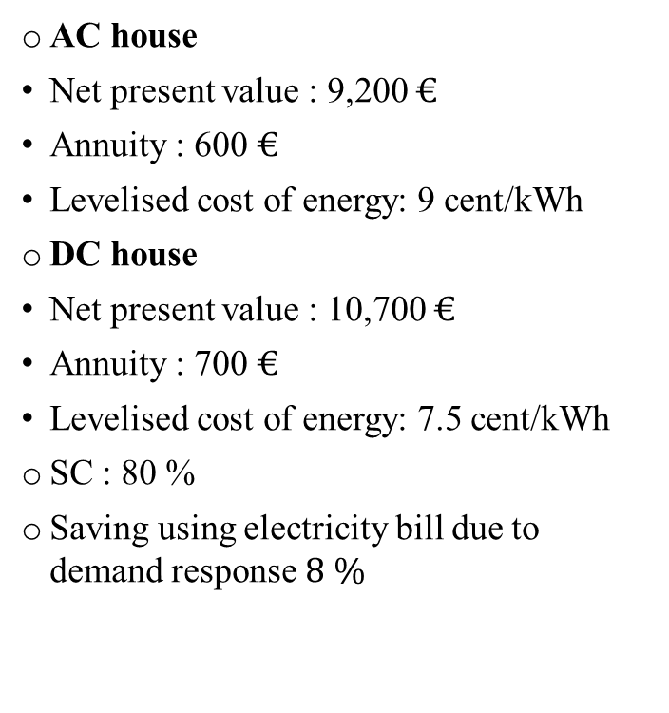
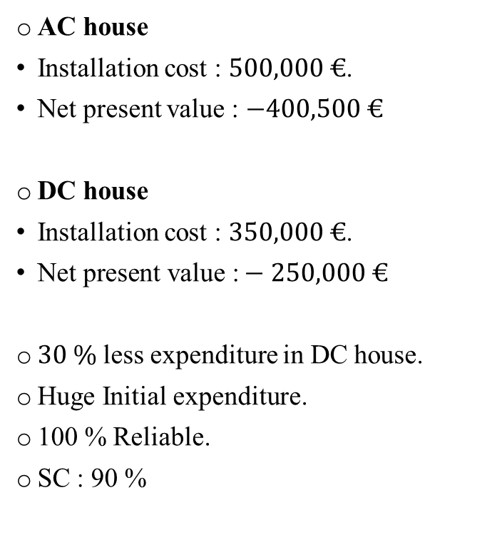
Economic analysis
Off grid
Price signal based DR
AC house
Installation cost : $500,000 €$.
Net present value : $−400,500 €$
DC house
Installation cost : $350,000 €$.
$\text{Net} \text{present} \text{value}\text{ :}−250,000 €$
$30 \%$ less expenditure in DC house.
Huge Initial expenditure.
100 % Reliable.
SC : 90 %
AC house
Net present value : 9,200 $€$
Annuity : 600 $€$
Levelised cost of energy: 9 cent/kWh
DC house
Net present value : 10,700 $€$
Annuity : 700 $€$
Levelised cost of energy: 7.5 cent/kWh
SC : 80 %
Saving using electricity bill due to demand response$8 \%$

Slide 16
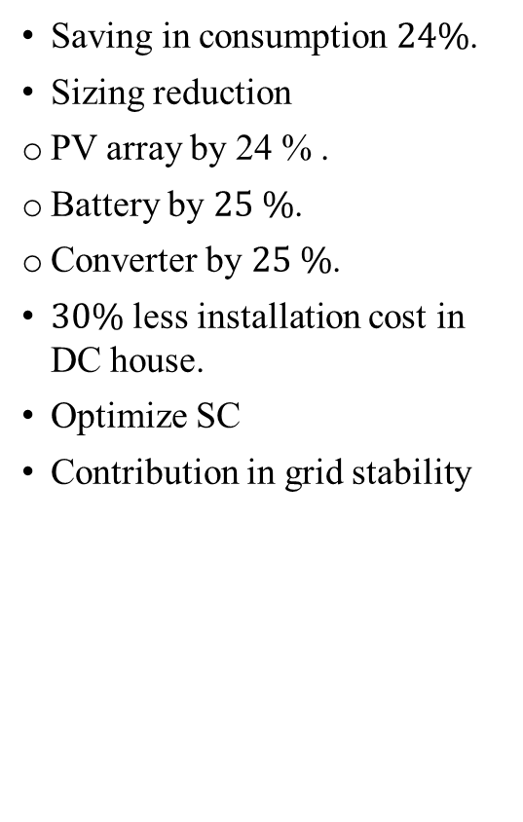
6. Conclusion
Saving in consumption $24\%$.
Sizing reduction
PV array by 24 % .
Battery by $25 \%$.
Converter by $25 \%$.
$30\%$ less installation cost in DC house.
Optimize SC
Contribution in grid stability

Slide 17
Thanks for your Attention

